Slide 1

Competitive Programming From Problem 2 Solution in O(1)
P
T
H
I
N
K
F
A
S
T
S
Installing Eclipse
Mostafa Saad Ibrahim
Teaching Assistant @ Cairo University

Slide 2
Installation Note
Any installation path or workspace path must be WITHOUT spaces
Steps:
Install Java Run Time
Get GCC Compiler
Download Eclipse C++ (Direct EXE for use)

Slide 3
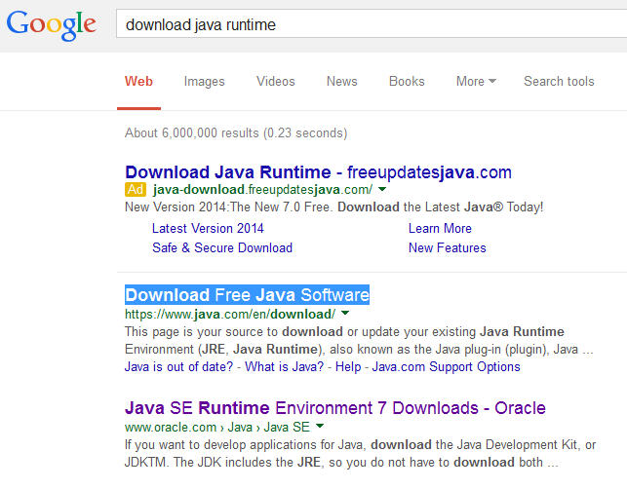
Java: Google it

Slide 4
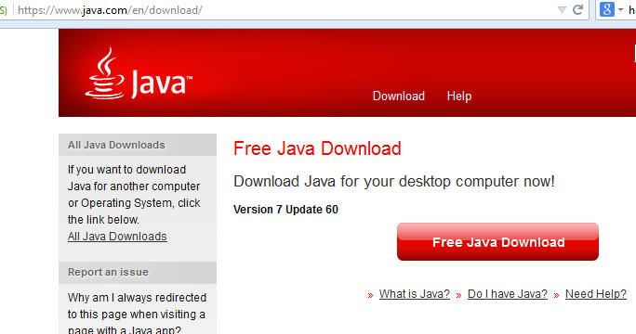
Java: Download & Install

Slide 5
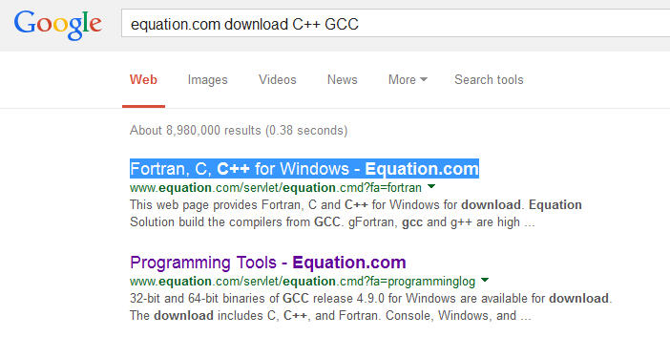
GCC: Google it

Slide 6
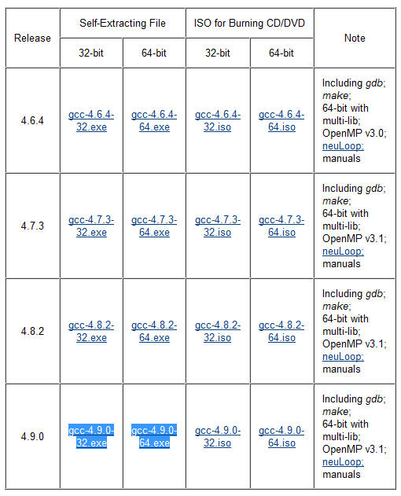
GCC: Download

Slide 7
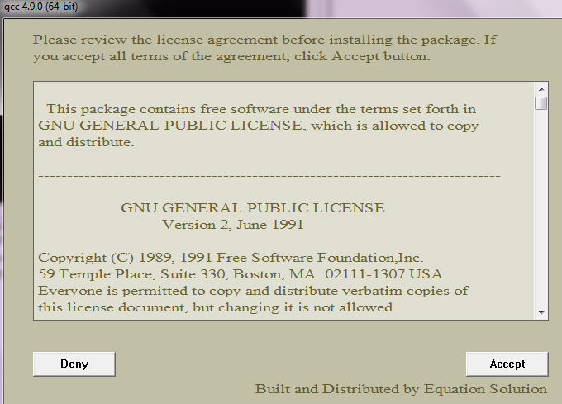
GCC: Install

Slide 8
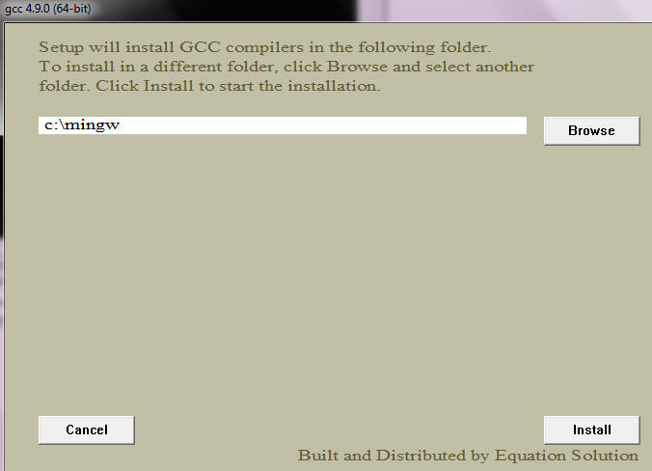
GCC: Browse No Space Path

Slide 9
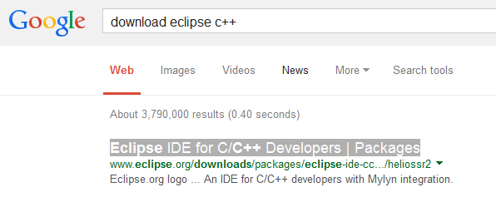
Eclipse: Google it

Slide 10
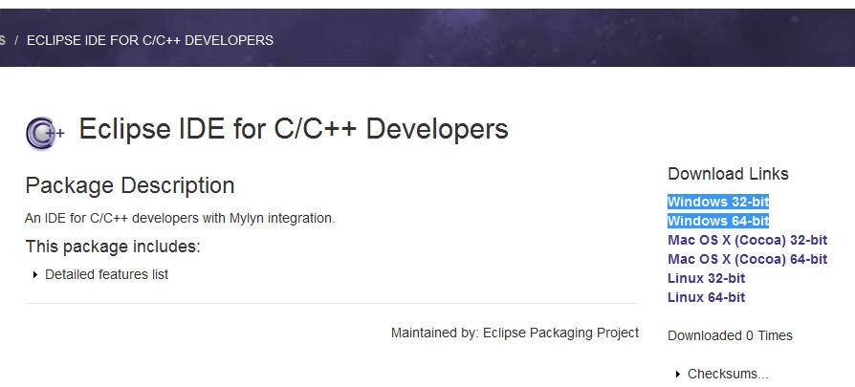
Eclipse: Download

Slide 11
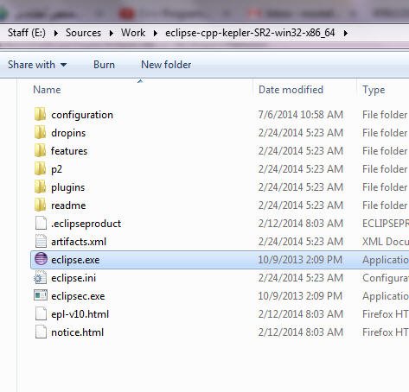
Eclipse: Extract ZIP

Slide 12
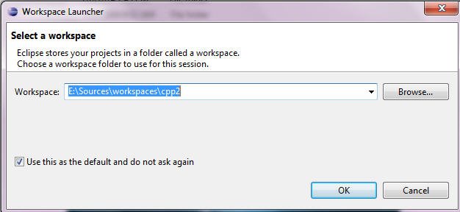
Eclipse: Select NO Spaces Path

Slide 13
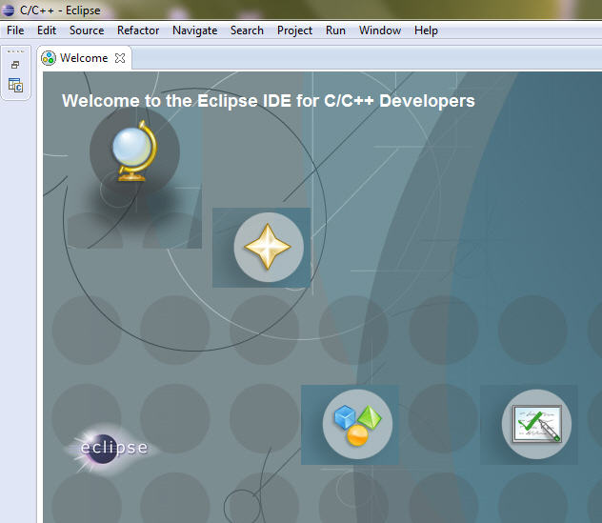
Eclipse: Lanuch

Slide 14
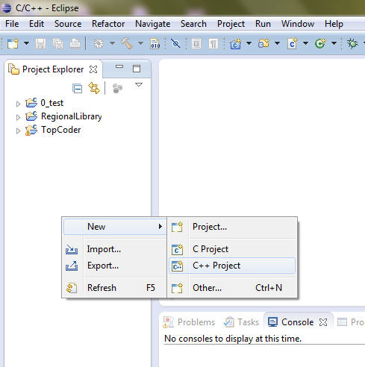
Eclipse: New C++ Project

Slide 15
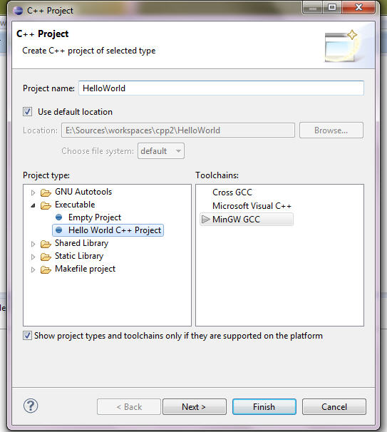
Eclipse: Hello World Project

Slide 16
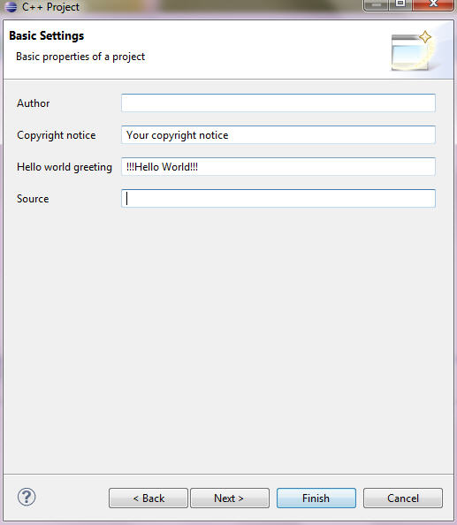
Eclipse: No Source Folder

Slide 17
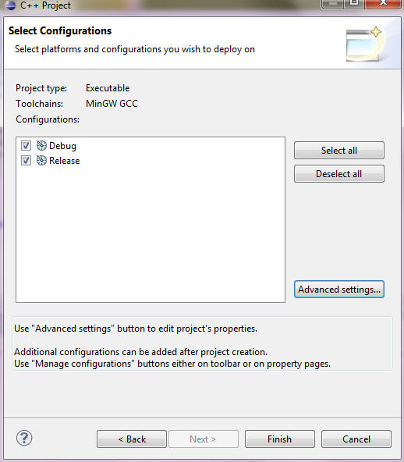
Eclipse: Advanced Settings

Slide 18
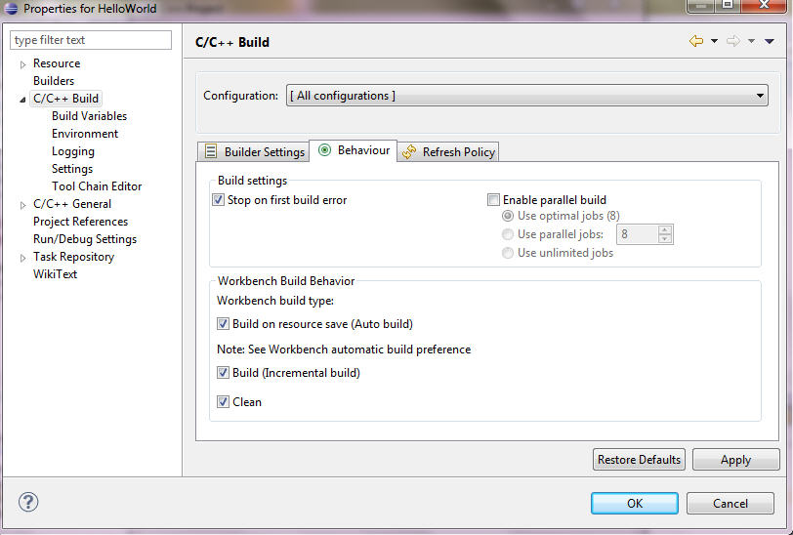
Eclipse: AutoBuild Feature

Slide 19
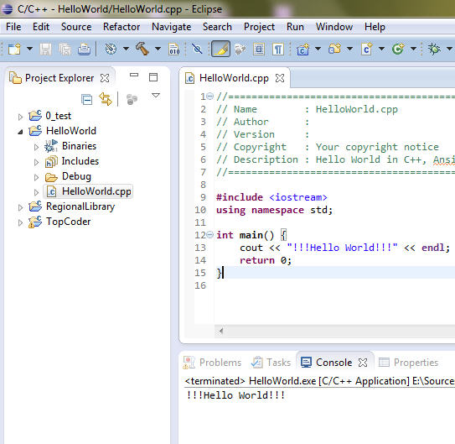
Eclipse: Build and Run

Slide 20
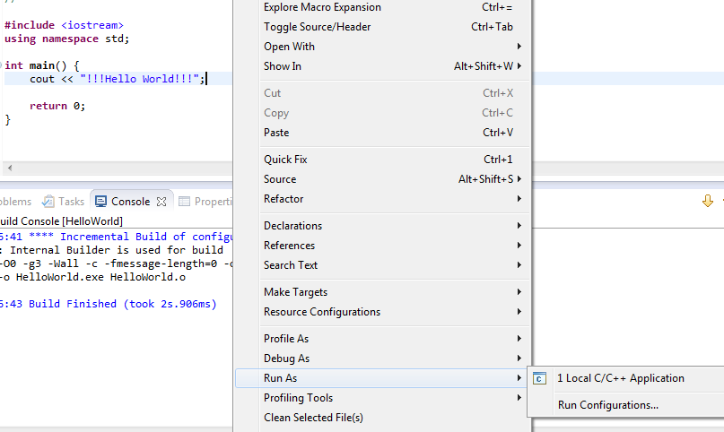
Eclipse: Run Or Ctrl+F11

Slide 21
Optional
Notes and Tricks

Slide 22
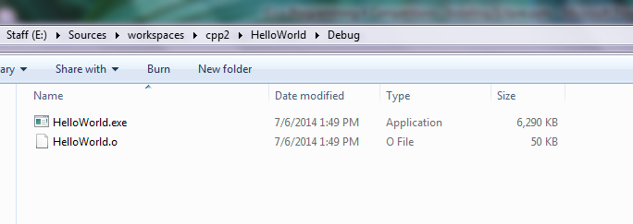
Eclipse: Object File
Build Command updates this file and then the exe
Compiler generates Object file, and linker use it to generate executable (exe)

Slide 23
Eclipse: Executable
Run Command run this file
If code is updated and No Build command is issued, this file will display old program
Always Close EXE to build/run again (hence exe is replaced with new one)

Slide 24
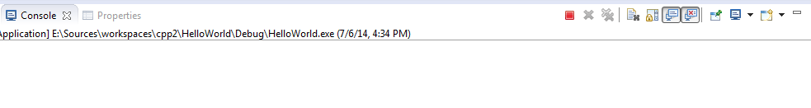
Eclipse: Running Program note

Slide 25
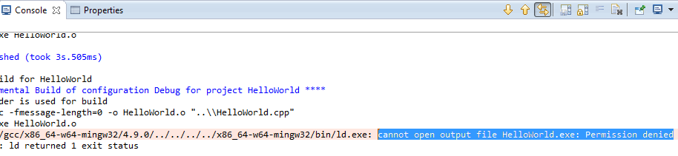
Eclipse: Another EXE running!!

Slide 26
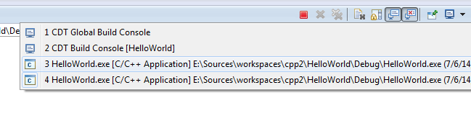
Eclipse: Running Programs

Slide 27
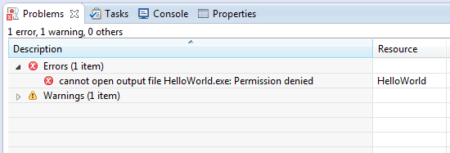
Eclipse: Problems Listing

Slide 28
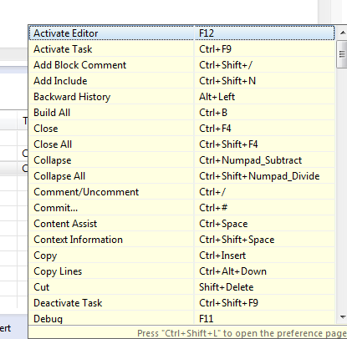
Eclipse: Shortcuts = Ctrl+Shift+L

Slide 29
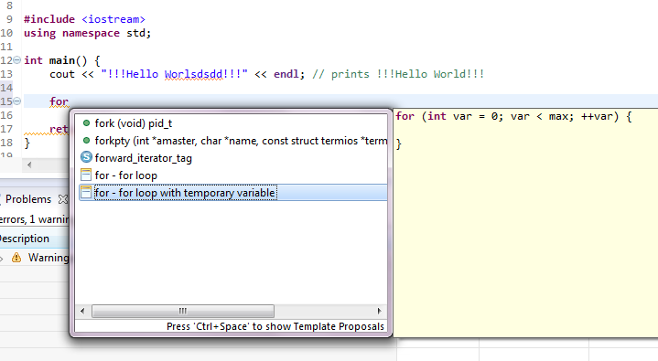
Eclipse: Auto Complete=Ctrl+Space

Slide 30
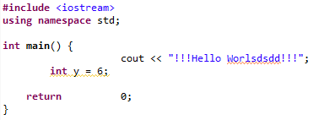
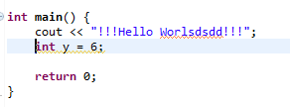
Eclipse: Format = Ctrl+Shift+F

Slide 31
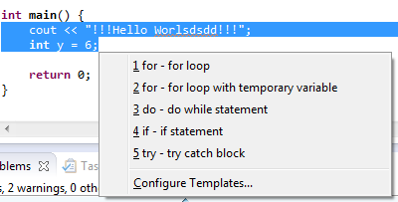
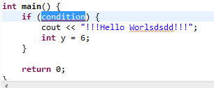
Eclipse: Block = Alt+Shift+Z

Slide 32
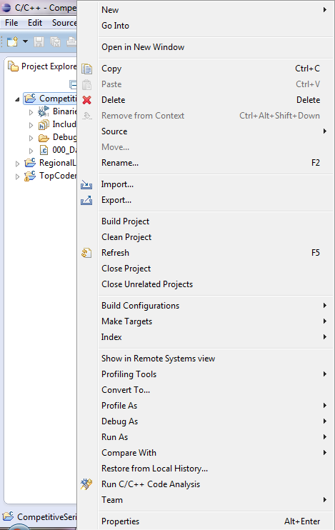
Eclipse: Project Menu
Clean Project helps if program has
compile errors already resolved
Close Project closes it
Close unrelated closes other projects
Restore from local history helps
If you need an old code
Properties gets project path and settings

Slide 33
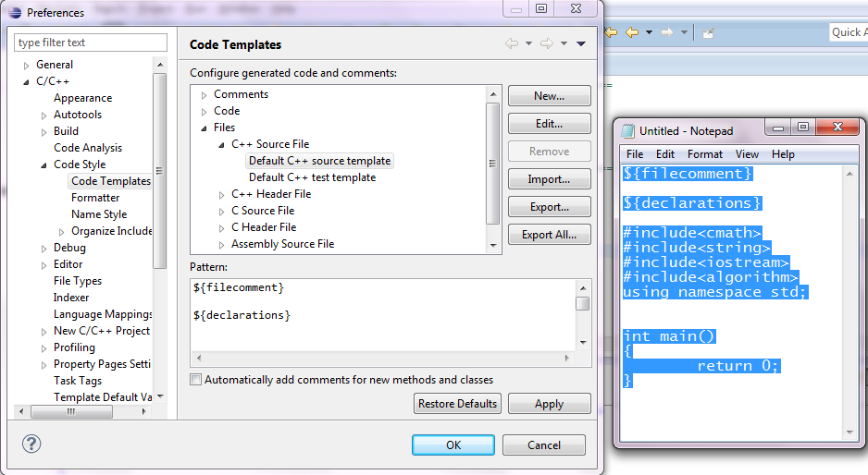
Eclipse: MyTemplate
Go to: Window => Preferences

Slide 34
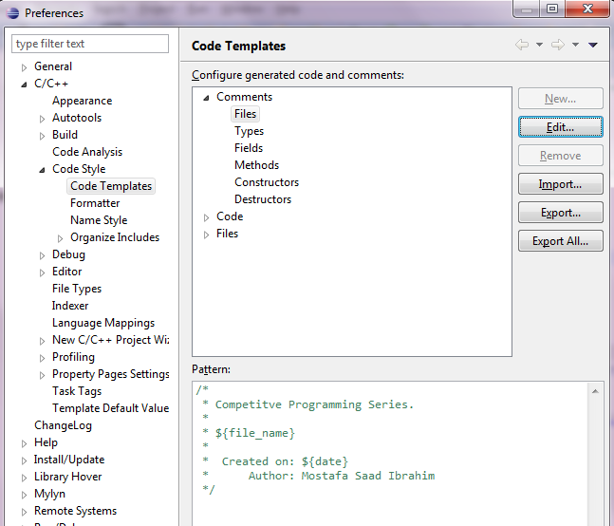
Eclipse: MyTemplate

Slide 35
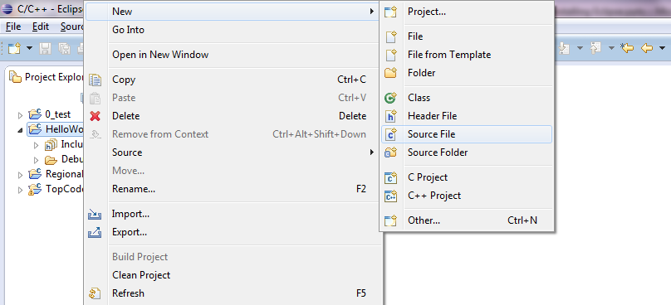
Eclipse: Create New CPP file

Slide 36
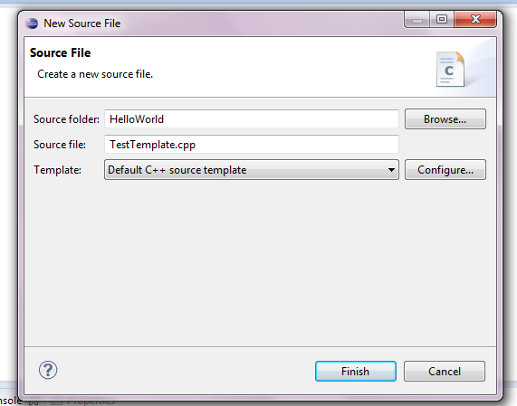
Eclipse: Give Name

Slide 37
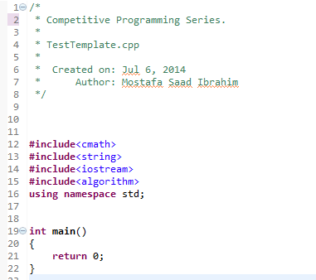
Eclipse: Cpp File with template

Slide 38
Eclipse: More Features
From time to time pick a menu and play with its content
Preferences Menu has too many nice options that you may like it
Be careful to not corrupt something..if did, see if there is default settings option

